Slide 1
Multifidelity Aeroelastic Optimization: Bibliographic Study
Author:
Giovanni QUAGLIA
Supervisors:
Pr. Joseph MORLIER
Pdf. Joan MAS COLOMER
21/05/2019

Slide 2
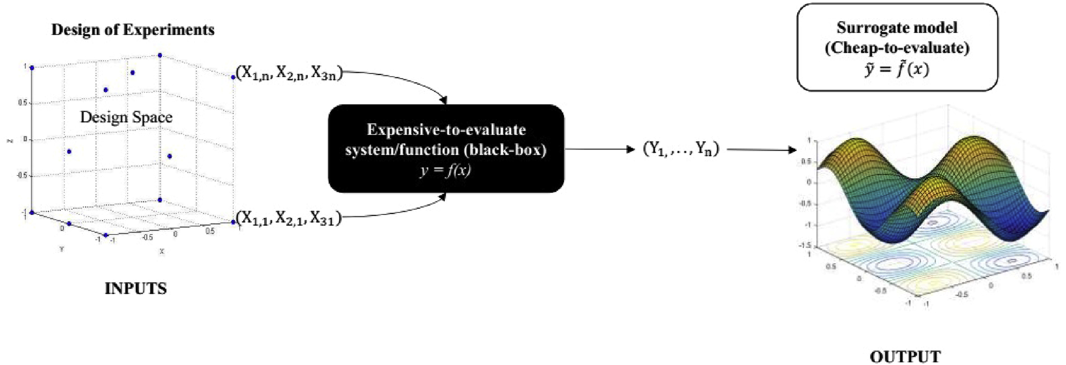
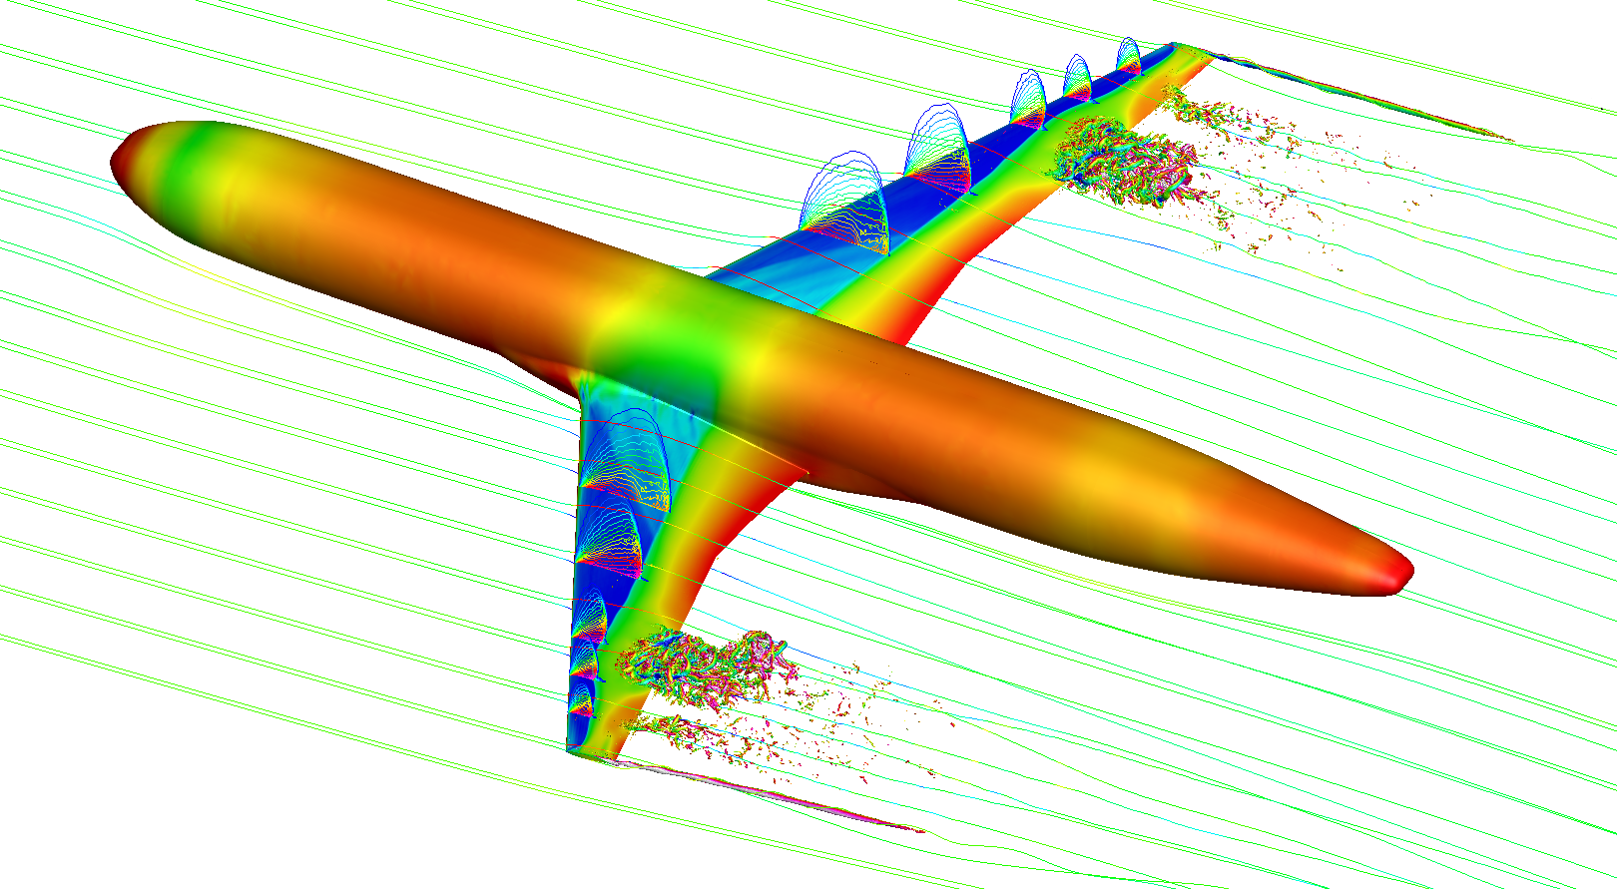
Context
The reduction of computational cost is a subject of major interest in aircraft design.
COMPLEX MODEL
Solution approaches: Multifidelity and Surrogate Models.

Slide 3
Summary
Black Box Aeroelastic Function
Multifidelity
Surrogate Models
Kriging
Co-Kriging
Optimization
SEGOMOE Framework
Future Work

Slide 4
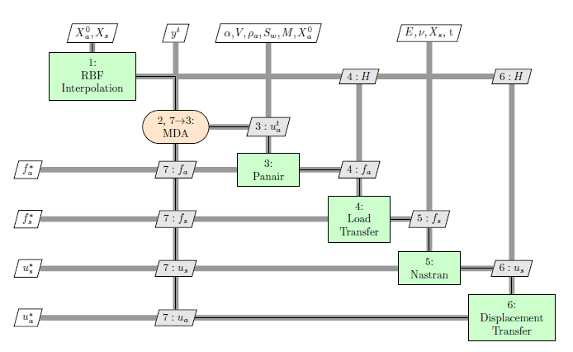
Black Box Aeroelastic Function
Fluid-Structure interaction problem is solved in an iterative partitioned approach.
Two separate aerodynamics and structural software are coupled together in a unique function.
OpenMDAO Model

Slide 5
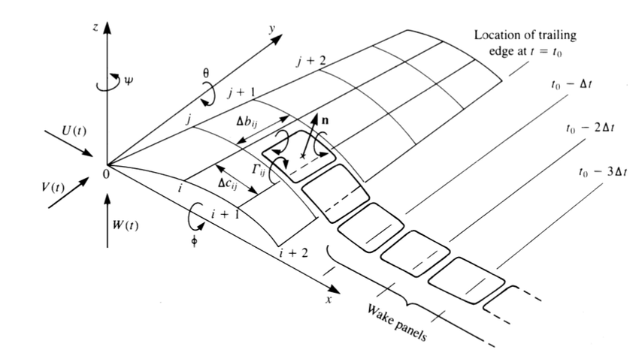
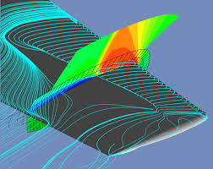
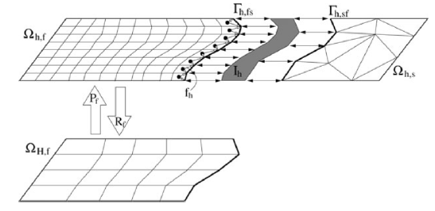
Multifidelity
The employment of functions with different accuracy and computational time can speed up the design process.
Examples:
High and Low fidelity software
Relaxed convergence criterion
Various mesh resolutions
Experiments

Slide 6
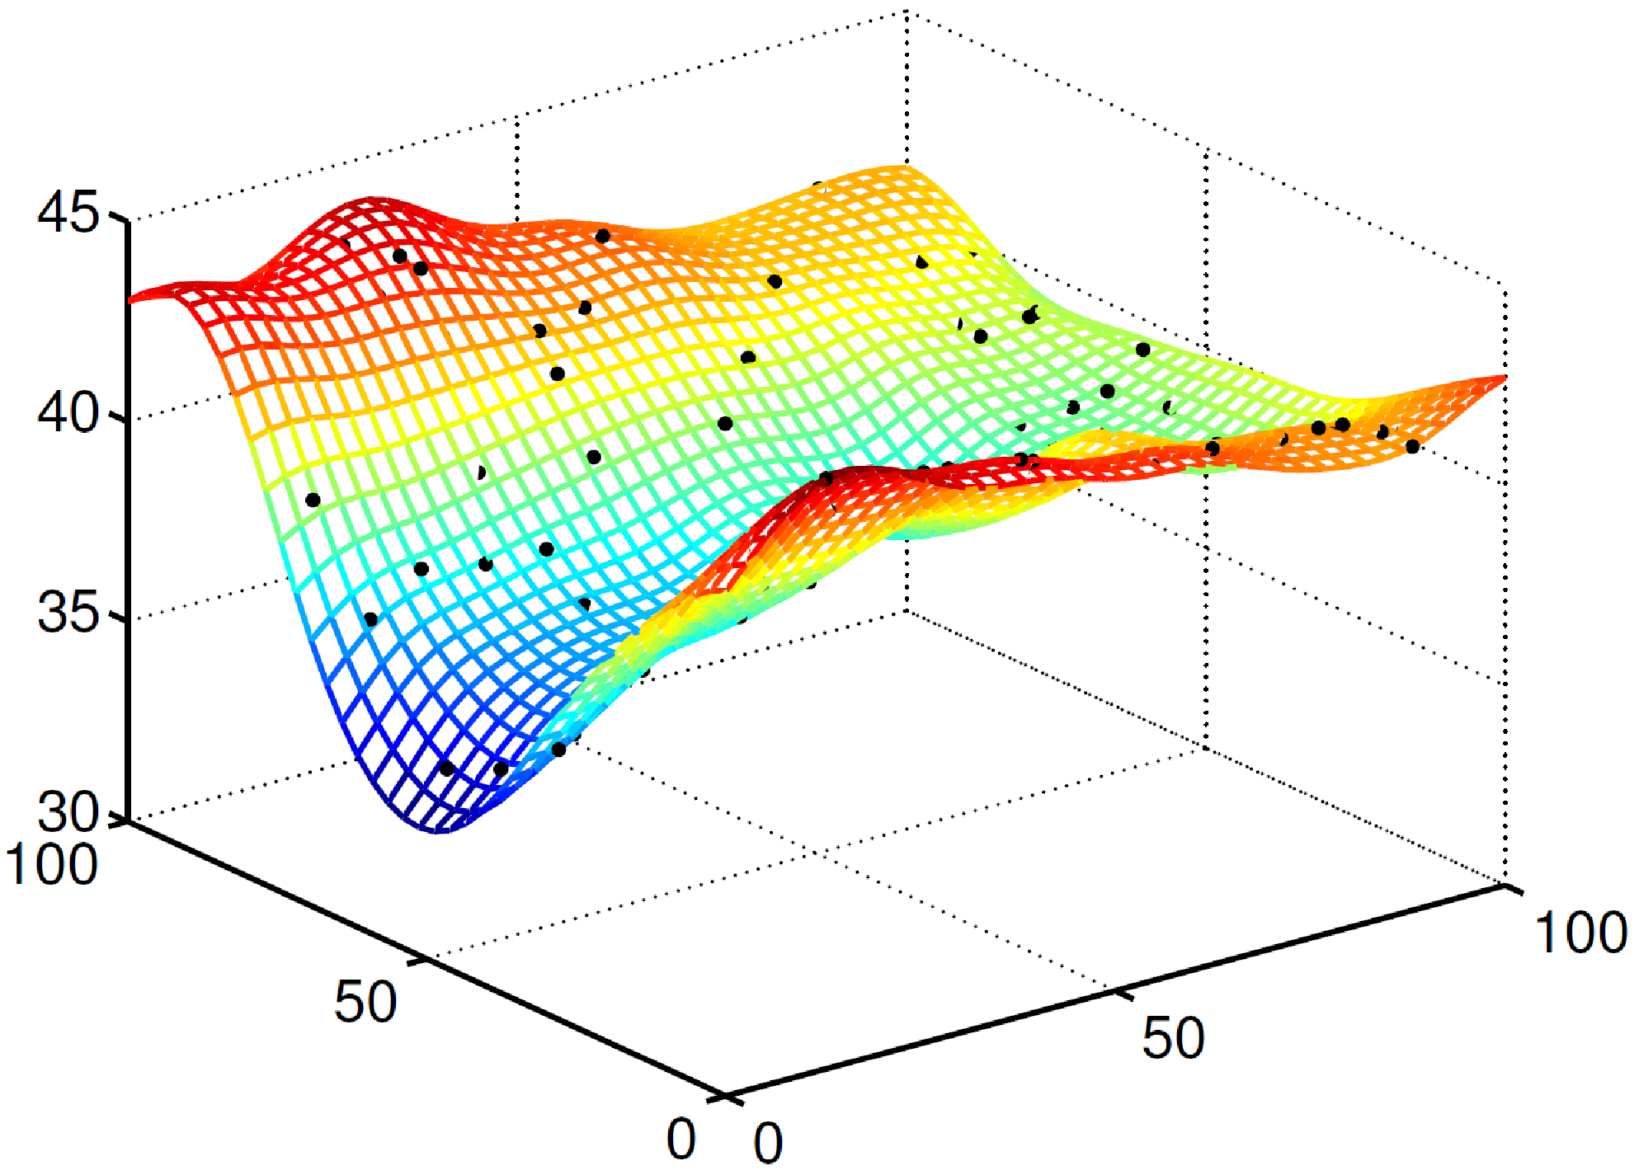
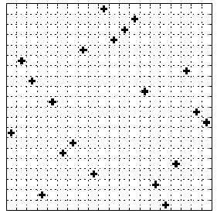
Surrogate Model
Computational cost is decreased analyzing a surrogate model of the real function.
DOE Sampling
Ex. LHS
Interpolation
Ex. Kriging, Co-Kriging

Slide 7
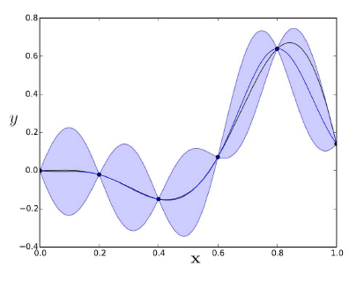
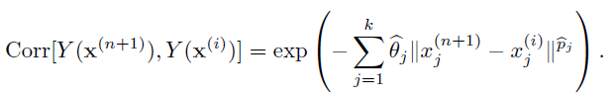
Surrogate Model
Kriging interpolation fits data to a Gaussian Process with constant mean and a defined covariance.
Uncertainty on the prediction is zero in the sampled points and increases with distance.

Slide 8
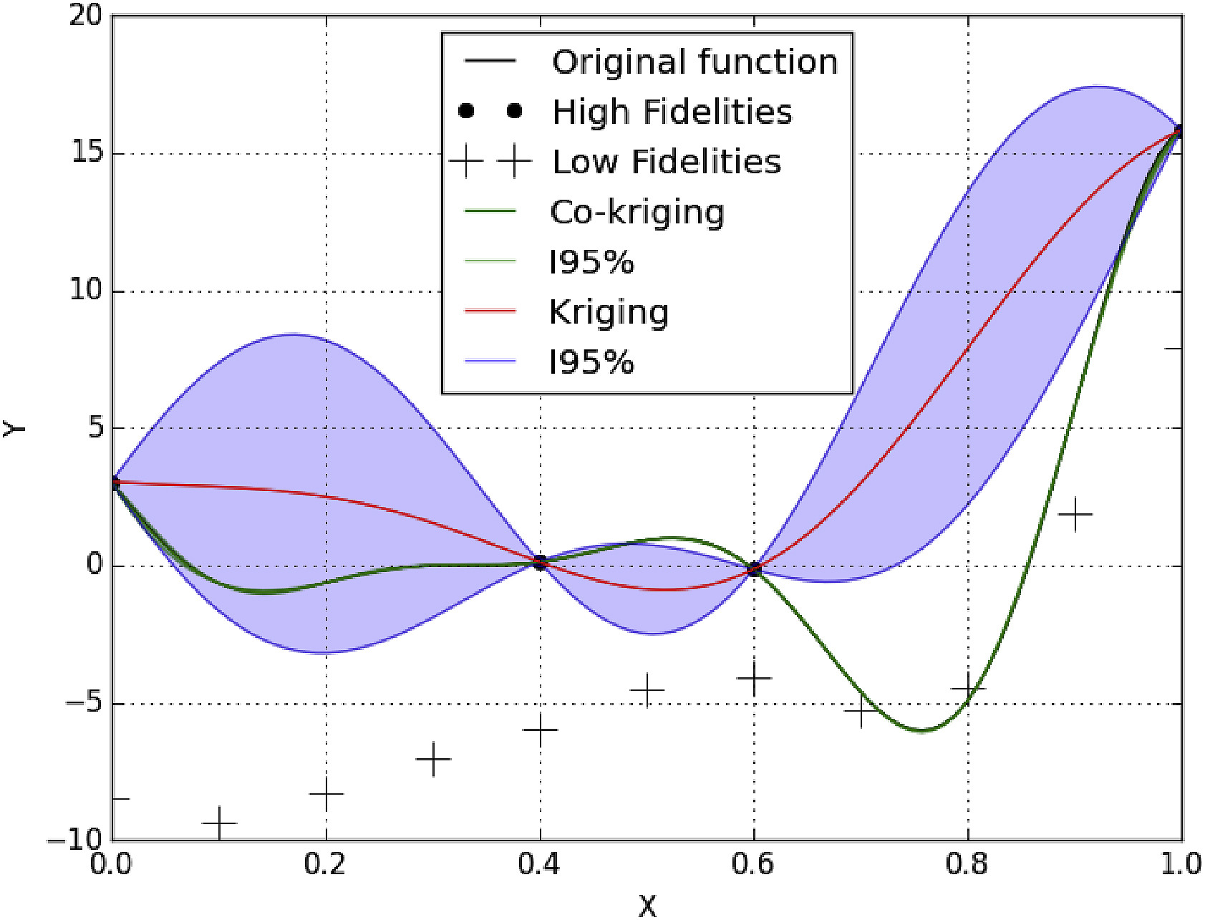
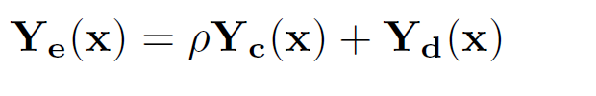
Surrogate Model
Co-Kriging interpolation takes into account data from two sources of different fidelity.
The prediction is based on the error between the High and Low Fidelity models.
Then a lower number of HF evaluations is required to build the surrogate model.

Slide 9
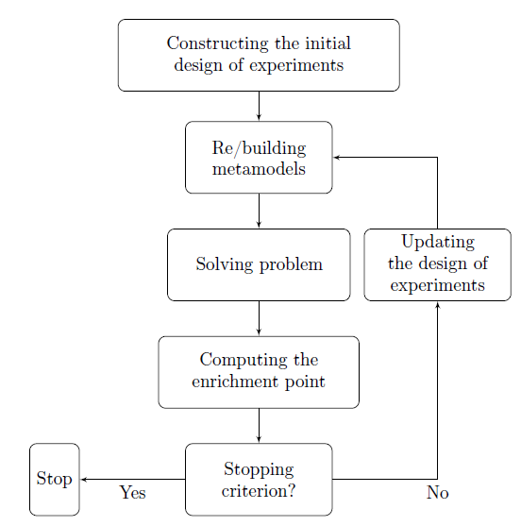
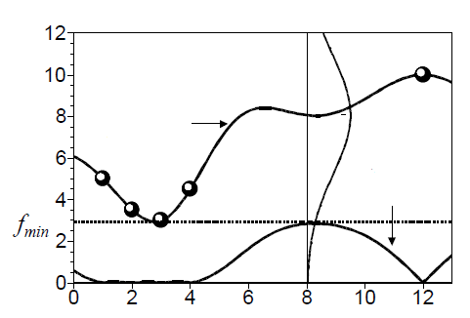
Optimization
Variable optimization can be performed on the surrogate model.
Probability
Prediction
Expected Improvement
The optimum research balances exploration and exploitation considering the model uncertainty.

Slide 10
SEGOMOE Framework
ISAE Supaero and ONERA developed the SEGOMOE Framework in a joint project:
Multifidelity samples are clustered under different surrogate models (MFK, KPLS(-K), RBS, PA2, PA3, …)
Clusters are merged by a EM algorithm in a Gaussian Mixture Model
WB2 optimum criterion
The framework is currently tested on the NASA CRM concept.

Slide 11
Future Work
PIR Planning:
May
June
Bibliographic research
21 May: bibliographic presentation
Create a CRM Low fidelity structural model
Development of a more general structural simplification algorithm
PIR final presentation

Slide 12
References
[Bartoli et al., 2016] Bartoli, N., Kurek, I., Lafage, R., Lefebvre, T., Priem, R., Bouhlel, M. A.,
Morlier, J., Stilz, V., and Regis, R. (2016). Improvement of efficient global optimization with mixture of experts: methodology developments and preliminary results in aircraft wing design.
[Mas-Colomer, 2018] Mas-Colomer, J. (2018). Aeroelastic Similarity of a Flight Demonstrator via
Multidisciplinary Optimization. PhD thesis.
[Jones et al., 1998] Jones, D. R., Schonlau, M., and Welch, W. J. (1998). Efficient global optimization
of expensive black-box functions. Journal of Global Optimization, 13(4):455–492.
[Scholcz, 2015] Scholcz, T. (2015). Multi-fidelity methods for fluid-structure interaction and uncertainty
quantification.
[Jones, 2001] Jones, D. R. (2001). A taxonomy of global optimization methods based on response
surfaces. Journal of Global Optimization, 21(4):345–383.
[Forrester et al., 2007] Forrester, A. I., Sóbester, A., and Keane, A. J. (2007). Multi-fidelity optimization via surrogate modelling. Proceedings of the Royal Society A: Mathematical, Physical and Engineering Sciences, 463(2088):3251–3269.

Slide 13
Thanks for your attention!
Any questions?

